Slide 1
Learning from Anticipatory Action Pilots
Center for Disaster Protection | September 22, 2020
Emilie Gettliffe and Ruth Hill

Slide 2
UN-OCHA is undertaking anticipatory action (AA) pilots for drought in Somalia (continued from 2019) and Ethiopia, and floods in Bangladesh.
The Centre is supporting UN-OCHA’s learning from the pilots. Three areas for learning have been identified:
the process to put in place the action plans and benefits arising from this,
the delivery of timely support to at-risk households when the actions have been triggered, and
the impact of triggered actions on household welfare.
Background

Slide 3
Overview of theory of change and three learning buckets:
Process Learning
Monitoring delivery
Evaluating impact
Process learning in 2 pilots: initial reflections from Somalia and Bangladesh
IE plans for Bangladesh
Slides Outline

Slide 4

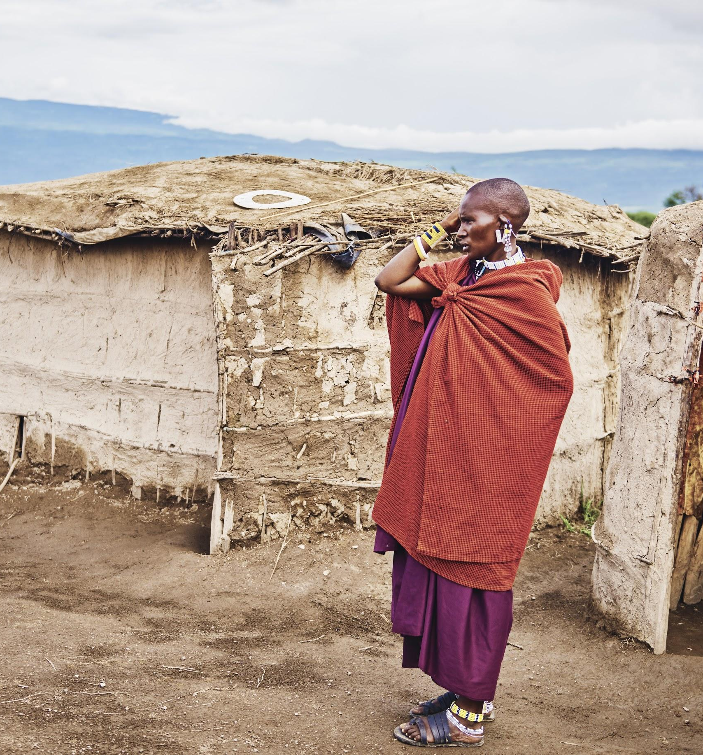
1. Theory of change and overview of learning buckets

Slide 5
Long term Outcomes
UN-OCHA ANTICIPATORY ACTION PILOTS – THEORY OF CHANGE
Acting earlier for a more impactful response
Intermediate Outcomes
Activities
Outputs
1. Improved coordination of aid delivery amongst UN agencies in pilot countries
A. CERF changes permanently to embed Anticipatory Action as a core, standard part of crisis response
i. Activities to promote Anticipatory Action (AA), joint working and shared approaches across UN agencies in all pilot countries
a. Early Action Plans in each pilot country with automated decision points approved by UN Resident Coordinators and HCs
2. Improved decision-making by UN agencies in pilot countries for drought, flood & cholera
ii. Country level analysis to identify priority risks, feasible early actions to mitigate impacts, corresponding triggers and appropriate delivery mechanisms.
B. Actors across the humanitarian and development sectors adopt similar systems, processes and emphasis on early provision of crisis support
3. More cost-effective response in pilot countries across drought, flood & cholera
iii. Joint planning processes in each country that identify opportunities for coordination in delivery across agencies
b. If triggered, CERF funds provided at the expected time to UN agencies
4. More timely response in the pilot countries across drought, flood & cholera meaning that fewer households start / engage in negative coping strategies
C. The International crisis financing system shifts to deliver more support quickly, reliably and in ways that mitigate (rather than just respond to) impacts
iv. Review of agency systems, capacities and processes to facilitate rapid flow of funds for AA
5. Vulnerable households experience lower welfare impacts from drought, flood & cholera in pilot countries
c. High quality lessons learned reports and evaluatory evidence publicly available
D. International humanitarian responses increase the dignity of those coping with predictable shocks
v. Creation of a central monitoring, evaluation and learning framework to identify lessons and evidence from large scale anticipatory action across all pilots
6. Improved global evidence base on the benefits of early action and on how to successfully undertake AA
Impact
Reduced impact of global crises on poor & vulnerable people, reduced humanitarian needs overall
7. More organisations follow OCHA’s lead and trial Anticipatory Action
Underlying problems:
Slow crisis responses where people are not reached at the optimum time either to mitigate impacts or for cost-effectiveness.
Uncoordinated humanitarian responses that do not cumulatively meet all needs of households in crisis settings.
A global humanitarian architecture which is built on a ‘wait and see’ mentality & limited evidence that Anticipatory Action is feasible or desirable
NOTE: Blue shading refers to outcomes that will only appear if early action is triggered.

Slide 6
Developing a real-time learning plan for pilots:
Process
Learning
Agree on major learning ‘buckets’ and critical learning questions
Confirm key process-related assumptions to test
Establish review periods to collect and collate data, reflect and integrate lessons

Slide 7
Procedural indicators:
Number of joint operations
Percentage of staff reporting improved decision-making
Monitoring delivery
Delivery indicators:
Cost per beneficiary reached is lower or amount of support provided per beneficiary reached is higher (relative to historic costs)
Beneficiaries reached more quickly than in a usual response (calculated based on historic response times)
Beneficiaries that report early intervention was important / they experienced less hardship / before they received support.
#3&4: agency reporting
#5: beneficiary assessments

Slide 8
Indicator:
6. Lower mortality, morbidity, income and asset losses amongst beneficiaries (relative to control)
Only done in cases where a control group can be identified, ideally through selection criteria (e.g. RDD) given no baseline data for PMT
Evaluating impact

Slide 9
Questions & Discussion

Slide 10
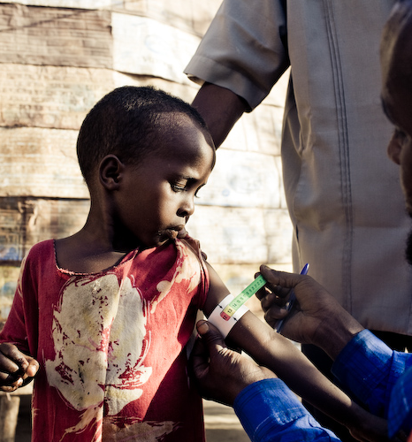
2. Process learning through two pilots: Somalia and Bangladesh

Slide 11
Purpose
To show how process-learning has supported the pilots and offered insights for improvement and adaptation.

Slide 12
Somalia:
Draft plan for drought completed Sept. 2019
The trigger (using projected food-insecurity) was not reached in 2019, though it came close
In June 2020, the trigger was reached, though not due to drought, but for the ”triple threat” of Covid-19, flooding and locusts
Funds were disbursed in July 2020, and activities are now ongoing for three months
Bangladesh:
Draft plan for monsoon flooding was completed end of June 2020
10-day pre-activation trigger was reached July 4, and 5-day trigger was reached July 11
Confirmation of funding disbursement was sent, and activities were largely implemented within 10 days, prior to the peak of the floods.
Background:
Anticipatory action pilots in Somalia and Bangladesh

Slide 13
Process-learning methodology
Process Learning is how OCHA is collecting qualitative data on how to do anticipatory action.
Somalia Report is based on ex-post research and real-time observation
Bangladesh Lessons Learned Report is based on real-time learning through discussions and observation
Desk review of relevant documents
Qualitative interviews:
OCHA/CERF colleagues
In-country, HQ and regional colleagues from partner UN agencies and INGOs
Observation of technical meetings, as well as select OCHA team meetings.
Action learning discussions on whether hypotheses and assumptions from the theory of change are holding true

Slide 14
Framing and approach (1 of 2)
Process learning allows for us to capture and share lessons in real-time.
OCHA has welcomed collaboration on learning with the Centre, and has been quite open to independent people:
asking questions to diverse partners and stakeholders
observing internal meetings
facilitating conversations on what is working or not
sharing results with partners for feedback
This transparency is crucial to advancing learning and incremental improvement on how to best design and implement anticipatory action.

Slide 15
Framing and approach (2 of 2)
The following ideas underpin the approach to process learning:
Learning requires gathering and listening to diverse views, openly sharing and discussing findings, bringing attention to important areas that emerge, and defining how that will inform future action.
Working in complexity requires recognizing and managing polarities, learning about and attending to the risks of getting out of balance.
When we see major challenges arise, the point is how we learn from them and integrate those lessons going forward.

Slide 16
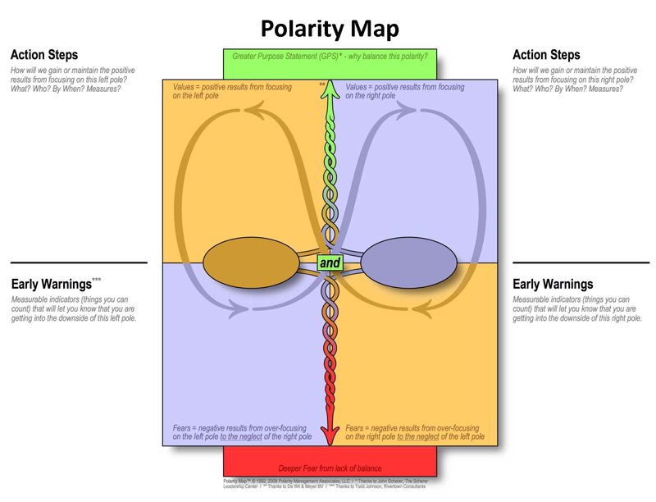
A note on polarities…
A polarity can be described as the relationship between two seemingly opposite poles that co-exist and have equal weight, often representing ongoing and unsolvable issues to navigate.
The benefits of recognizing polarities include:
Fosters “both/and” rather than binary “either/or” ways of thinking about what we’re learning
Allows varying perspectives to be honored about what is important and why
Help surface the complexities at hand and what is calling for more attention
Being thoughtful
Taking time to plan
Coordinating activities with others
Getting a lot done
Not hesitating and “going for it”
Taking action when/ where it’s needed
Slowing down
Speeding up
Getting stuck in inaction
Procrastinating
Neglecting urgent needs
Burning out
Making sloppy mistakes
Working fast but not smart

Slide 17
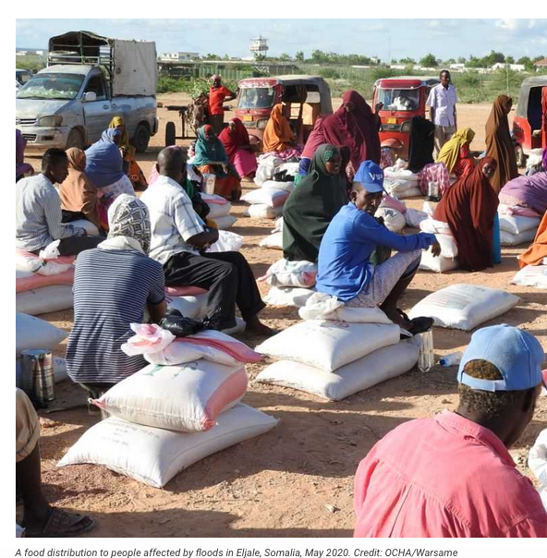
Overarching Lessons – Somalia (1 of 2)
Significant hurdles in generating country-level engagement and trust, as well as ambiguities in concepts and decision-making processes led to a challenging first pilot, with the following key lessons emerging:
1. There are trade-offs between speed of delivering the pilot and generating understanding and ownership in a country with little prior anticipatory action experience
2. Establishing relevant triggers requires:
starting with existing systems and capacity
identifying feasible interventions to mitigate the impacts of a shock that account for operational readiness
working back to build the plan and trigger
establishing a clear monitoring plan

Slide 18
Overarching Lessons – Somalia (2 of 2)
3. AA funds have now been triggered for non-drought specific crises, shifting the nature of the pilot (though maintaining prior planned interventions that remain relevant), and impacting decision-making processes.
4. Partnership with the World Bank offered opportunities for additional financing and partnership, as well as added challenges to negotiate in managing HQ-led requirements with country-level recommendations and concerns.

Slide 19
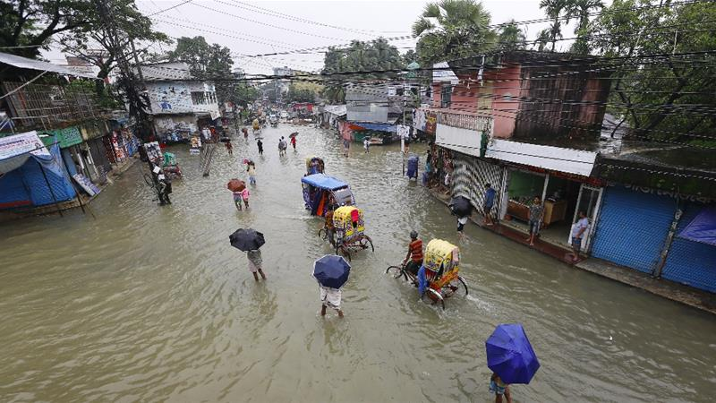
Overarching Lessons – Bangladesh (1 of 1)
Thanks to significant prior FBF and FBA experience and expertise, OCHA’s strong coordination role, and trusting and transparent partnerships, the pilot served its purpose by:
Demonstrating the feasibility of scaling anticipatory action with CERF funding
Bringing greater international attention to the potential value and impact of acting in advance of a disaster where possible
Reminding partners what is achievable in a short amount of time when a motivated “coalition of the willing” comes together around a clear common goal
Generating significant learning on administrative bottle-necks and hurdles to overcome for rapid onset disasters
Photo Credit: Sultan Mahmud/AFP

Slide 20
“Work-shopping” polarities at play in AA pilots to identify areas needing more attention going forward (examples)
Drive forward a vision for impactful global change
Establish pre-agreed terms and methods
Build foundations of trust, partnership, systems and expertise
Listen to and build from existing in-country systems
Engage in a process of co-discovering solutions
Pressure to deliver “proof-of-concept” that generates buy-in and momentum

Slide 21
Questions & Discussion

Slide 22
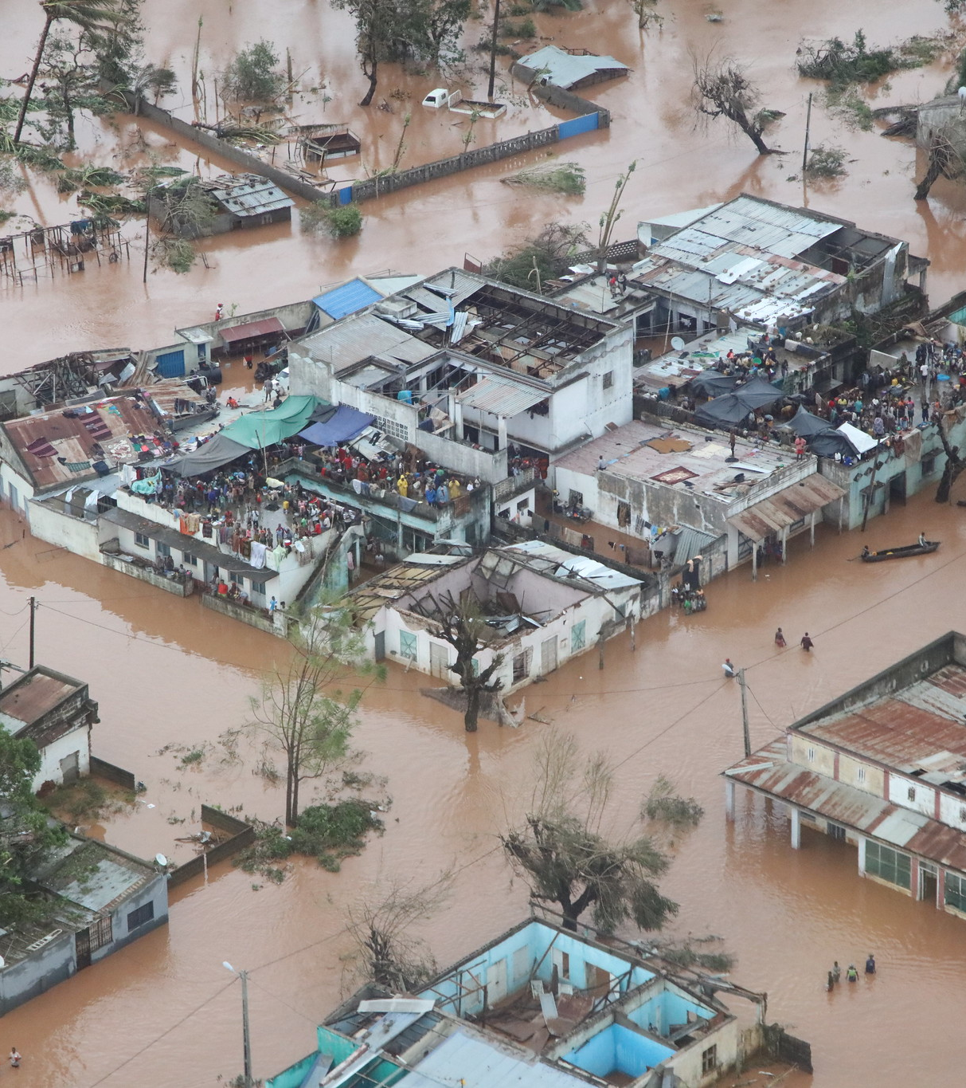
3. Evaluating impact in Bangladesh

Slide 23
Objective: quantitative impact of WFP’s anticipatory cash transfers on household welfare (food security, lower welfare losses from flooding and greater peace of mind). Replication study to Gros et al 2019, larger N.
Method: post-evaluation using a well identified control group (baseline characteristics compared where possible).
Control group: comparing receiving an AA transfer to not. Using the fact that, given covid, predefined lists had to be used.
Initial plan: an RDD around the union flood depth cutoff.
Revised plan: those who did not have the right e-wallet.
Timing: looking at timing (earlier versus later transfer) through geographic variation in timing compared to peak flooding, and delays in some households activating wallets.
Data collection: by phone which is challenging, but using a local household survey firm that has done surveys on flood impacts on households since the 1990s.
Evaluation of 2020 anticipatory action: WFP cash transfers

Slide 24
Questions & Discussion

Slide 25
Thank you

